Slide 1


Chapter 10:
Characters, C-Strings, and More About the string Class

Slide 2
10.1
Character Testing

Slide 3
Character Testing
require cctype header file
FUNCTION | MEANING
isalpha | true if arg. is a letter, false otherwise
isalnum | true if arg. is a letter or digit, false otherwise
isdigit | true if arg. is a digit 0-9, false otherwise
islower | true if arg. is lowercase letter, false otherwise
isprint | true if arg. is a printable character, false otherwise
ispunct | true if arg. is a punctuation character, false otherwise
isupper | true if arg. is an uppercase letter, false otherwise
isspace | true if arg. is a whitespace character, false otherwise

Slide 4
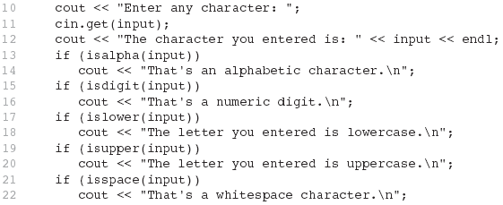
From Program 10-1

Slide 5
10.2
Character Case Conversion

Slide 6
Character Case Conversion
Require cctype header file
Functions:
  toupper: if char argument is lowercase letter, return uppercase equivalent; otherwise, return input unchanged
  char ch1 = 'H';
  char ch2 = 'e';
  char ch3 = '!';
  cout << toupper(ch1); // displays 'H'
  cout << toupper(ch2); // displays 'E'
  cout << toupper(ch3); // displays '!'

Slide 7
Character Case Conversion
Functions:
  tolower: if char argument is uppercase letter, return lowercase equivalent; otherwise, return input unchanged
  char ch1 = 'H';
  char ch2 = 'e';
  char ch3 = '!';
  cout << tolower(ch1); // displays 'h'
  cout << tolower(ch2); // displays 'e'
  cout << tolower(ch3); // displays '!'

Slide 8
switch (color)
{
case 'b':
case 'B': cout << "Strong";
break;
case 'g':
case 'G': cout << "Growth";
break;
case 'r':
case 'R': cout << "Love";
break;
case 'y':
case 'Y': cout << "Happy";
break;
}// end of switch

Slide 9
switch (color)
{
case 'b':
case 'B': cout << "Strong";
break;
case 'g':
case 'G': cout << "Growth";
break;
case 'r':
case 'R': cout << "Love";
break;
case 'y':
case 'Y': cout << "Happy";
break;
}// end of switch
color = toupper(color);
switch (color)
{
case 'B': cout << "Strong";
break;
case 'G': cout << "Growth";
break;
case 'R': cout << "Love";
break;
case 'Y': cout << "Happy";
break;
}// end of switch

Slide 10
10.3
C-Strings

Slide 11
C-Strings
C-string: sequence of characters stored in adjacent memory locations and terminated by NULL character
String literal (string constant): sequence of characters enclosed in double quotes " " : "Hi there!"
H
i
t
h
e
r
e
!
\0

Slide 12
C-Strings
Array of chars can be used to define storage for string:
const int SIZE = 20;
char city[SIZE];
Leave room for NULL at end
Can enter a value using cin or >>
  Input is whitespace-terminated
  No check to see if enough space
For input containing whitespace, and to control amount of input, use cin.getline()

Slide 13
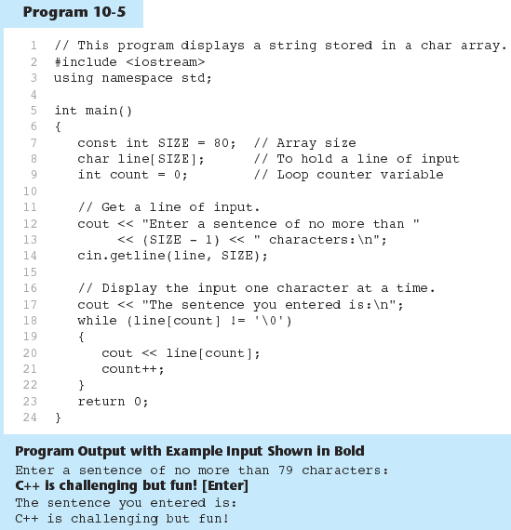

Slide 14
String – a sequence of characters treated as a unit.
C String – an array of characters delimited by the null character, '\0'
char s[6] = {'B', 'e', 'n', '\0'};
0 1 2 3 4 5
B
e
n
\0
\0
\0
char s[6] = "Ben";
0 1 2 3 4 5
B
e
n
\0
\0
\0

Slide 15
char s[10] = "Mary";
char t[] = "Alex";
0 1 2 3 4 5 6 7 8 9
M
a
r
y
\0
\0
\0
\0
\0
\0
0 1 2 3 4
A
l
e
x
\0
sizeof (s) // sizeof s
sizeof (t) // sizeof t
// sizeof (char)
// sizeof (char *)
sizeof is a unary operator used to calculate the size of a data element or type (→ number of bytes).

Slide 16
char s[10] = "Mary";
char t[] = "Alex";
0 1 2 3 4 5 6 7 8 9
M
a
r
y
\0
\0
\0
\0
\0
\0
0 1 2 3 4
A
l
e
x
\0
sizeof (s) // 10
sizeof (t) // 4 + 1 = 5

Slide 17
char t[] = "Alexandra";
char *ptr = t;
0 1 2 3 4 5 6 7 8 9
A
l
e
x
a
n
d
r
a
\0
ptr
sizeof (t) // 9 + 1 = 10
sizeof (ptr) // ???
sizeof (ptr + 1) // ???

Slide 18
char t[] = "Alexandra";
char *ptr = t;
0 1 2 3 4 5 6 7 8 9
A
l
e
x
a
n
d
r
a
\0
ptr
sizeof (t) // 9 + 1 = 10
sizeof (ptr) // size of any pointer, usually 4 bytes
sizeof (ptr + 1) // 4

Slide 19
"A"
'a'
""
''

Slide 20
0 1
"A" // – string constant, 2 bytes
'a' // – character constant, 1 byte
"" // – empty string, 1 byte
'' // – not valid!
A
\0
e
\0

Slide 21
char s[10] = "mary";
char *p = "Alexandra";
0 1 2 3 4 5 6 7 8 9
m
a
r
y
\0
\0
\0
\0
\0
\0
0 1 2 3 4 5 6 7 8 9
A
l
e
x
a
n
d
r
a
\0
*s = 'M';

Slide 22
char s[10] = "mary";
char *p = "Alexandra";
0 1 2 3 4 5 6 7 8 9
M
a
r
y
\0
\0
\0
\0
\0
\0
0 1 2 3 4 5 6 7 8 9
A
l
e
x
a
n
d
r
a
\0
*s = 'M'; // OK

Slide 23
char s[10] = "mary";
char *p = "Alexandra";
0 1 2 3 4 5 6 7 8 9
M
a
r
y
\0
\0
\0
\0
\0
\0
0 1 2 3 4 5 6 7 8 9
A
l
e
x
a
n
d
r
a
\0
*s = 'M'; // OK
*p = 'a';

Slide 24
char s[10] = "mary";
char *p = "Alexandra";
0 1 2 3 4 5 6 7 8 9
M
a
r
y
\0
\0
\0
\0
\0
\0
0 1 2 3 4 5 6 7 8 9
A
l
e
x
a
n
d
r
a
\0
*s = 'M'; // OK
*p = 'a'; // cannot change a string constant!

Slide 25
char s[10] = "mary";
char *p = "Alexandra";
0 1 2 3 4 5 6 7 8 9
M
a
r
y
\0
\0
\0
\0
\0
\0
0 1 2 3 4 5 6 7 8 9
A
l
e
x
a
n
d
r
a
\0
*s = 'M'; // OK
*p = 'a'; // cannot change a string constant!
p++;

Slide 26
char s[10] = "mary";
char *p = "Alexandra";
0 1 2 3 4 5 6 7 8 9
M
a
r
y
\0
\0
\0
\0
\0
\0
0 1 2 3 4 5 6 7 8 9
A
l
e
x
a
n
d
r
a
\0
*s = 'M'; // OK
*p = 'a'; // cannot change a string constant!
p++; // OK: now p points to ‘a’

Slide 27
char s[10] = "mary";
char *p = "Alexandra";
0 1 2 3 4 5 6 7 8 9
M
a
r
y
\0
\0
\0
\0
\0
\0
0 1 2 3 4 5 6 7 8 9
A
l
e
x
a
n
d
r
a
\0
*s = 'M'; // OK
*p = 'a'; // cannot change a string constant!
p++; // OK: now p points to ‘a’
s++; // cannot change a pointer constant!

Slide 28
10.4
Library Functions for Working with C-Strings

Slide 29
Library Functions for Working with C-Strings
Require the cstring header file
Functions take one or more C-strings as arguments. Can use:
  C-string name
  pointer to C-string
  literal string

Slide 30
strlen
strcpy strncpy
strcmp strncmp
strcat strncat
strchr strrchr

Slide 31
char s[10] = "Victor";
String Length
0 1 2 3 4 5 6 7 8 9
V
i
c
t
o
r
\0
\0
\0
\0
sizeof (s) // 10
strlen (s) // ???

Slide 32
char s[10] = "Victor";
String Length
0 1 2 3 4 5 6 7 8 9
V
i
c
t
o
r
\0
\0
\0
\0
sizeof (s) // 10
strlen (s) // 6
int strlen (const char* );

Slide 33
char s[10] = "Monday";
char t[] = "Wednesday";
char u[10] = "";
char *p = s;
char *q = t + 3;
String Length
0 1 2 3 4 5 6 7 8 9
M
o
n
d
a
y
\0
\0
\0
\0
0 1 2 3 4 5 6 7 8 9
W
e
d
n
e
s
d
a
y
\0
strlen( s ) //
strlen( p ) //
strlen( s + 1 ) //
strlen( u ) //
strlen( t ) //
strlen( q ) //

Slide 34
char s[10] = "Monday";
char t[] = "Wednesday";
char u[10] = "";
char *p = s;
char *q = t + 3;
String Length
0 1 2 3 4 5 6 7 8 9
M
o
n
d
a
y
\0
\0
\0
\0
0 1 2 3 4 5 6 7 8 9
W
e
d
n
e
s
d
a
y
\0
strlen( s ) // 6
strlen( p ) // 6
strlen( s + 1 ) // 5
strlen( u ) // 0
strlen( t ) // 9
strlen( q ) // 6

Slide 35
char s[10];
String Length
0 1 2 3 4 5 6 7 8 9
M
o
n
d
a
y
\n
\0

Slide 36
char s[10];
String Length
0 1 2 3 4 5 6 7 8 9
M
o
n
d
a
y
\n
\0
*(s + strlen(s) – 1) = '\0';
0 1 2 3 4 5 6 7 8 9
M
o
n
d
a
y
\0
\0

Slide 37
Library Functions for
Working with C-Strings
Functions:
  strlen(str): returns length of C-string str
    char city[SIZE] = "Missoula";
    cout << strlen(city); // prints 8
  strcat(str1, str2): appends str2 to the end of str1
    char location[SIZE] = "Missoula, ";
    char state[3] = "MT";
    strcat(location, state);
    // location now has "Missoula, MT"

Slide 38
Library Functions for
Working with C-Strings
Functions:
  strcpy(str1, str2): copies str2 to str1
  const int SIZE = 20;
  char fname[SIZE] = "Maureen", name[SIZE];
  strcpy(name, fname);
  Note: strcat and strcpy perform no bounds checking to determine if there is enough space in receiving character array to hold the string it is being assigned.

Slide 39
C-string Inside a C-string
Function:
  strstr(str1, str2): finds the first occurrence of str2 in str1. Returns a pointer to match, or NULL if no match.
    char river[] = "Wabash";
    char word[] = "aba";
    cout << strstr(state, word);
    // displays "abash"

Slide 40
char s[10] = "One Two 3";
char t[10] = "April 26";
strlen
0 1 2 3 4 5 6 7 8 9
O
n
e
T
w
o
3
\0
0 1 2 3 4 5 6 7 8 9
A
p
r
i
l
2
6
\0
\0
strlen( s ) //
strlen( s + 4 ) //
strlen( s + 8 ) //
strlen( t ) //
strlen( t ) + 6 //
strlen( t + 6 ) //
“When a string-handling function is given an address, it starts the manipulation of the string at that address and continues until it encounters the ‘\0’ character.”

Slide 41
char s[10] = "One Two 3";
char t[10] = "April 26";
strlen
0 1 2 3 4 5 6 7 8 9
O
n
e
T
w
o
3
\0
0 1 2 3 4 5 6 7 8 9
A
p
r
i
l
2
6
\0
\0
strlen( s ) // 9
strlen( s + 4 ) //
strlen( s + 8 ) //
strlen( t ) //
strlen( t ) + 6 //
strlen( t + 6 ) //

Slide 42
char s[10] = "One Two 3";
char t[10] = "April 26";
strlen
0 1 2 3 4 5 6 7 8 9
O
n
e
T
w
o
3
\0
0 1 2 3 4 5 6 7 8 9
A
p
r
i
l
2
6
\0
\0
strlen( s ) // 9
strlen( s + 4 ) // 5
strlen( s + 8 ) //
strlen( t ) //
strlen( t ) + 6 //
strlen( t + 6 ) //

Slide 43
char s[10] = "One Two 3";
char t[10] = "April 26";
strlen
0 1 2 3 4 5 6 7 8 9
O
n
e
T
w
o
3
\0
0 1 2 3 4 5 6 7 8 9
A
p
r
i
l
2
6
\0
\0
strlen( s ) // 9
strlen( s + 4 ) // 5
strlen( s + 8 ) // 1
strlen( t ) //
strlen( t ) + 6 //
strlen( t + 6 ) //

Slide 44
char s[10] = "One Two 3";
char t[10] = "April 26";
strlen
0 1 2 3 4 5 6 7 8 9
O
n
e
T
w
o
3
\0
0 1 2 3 4 5 6 7 8 9
A
p
r
i
l
2
6
\0
\0
strlen( s ) // 9
strlen( s + 4 ) // 5
strlen( s + 8 ) // 1
strlen( t ) // 8
strlen( t ) + 6 //
strlen( t + 6 ) //

Slide 45
char s[10] = "One Two 3";
char t[10] = "April 26";
strlen
0 1 2 3 4 5 6 7 8 9
O
n
e
T
w
o
3
\0
0 1 2 3 4 5 6 7 8 9
A
p
r
i
l
2
6
\0
\0
strlen( s ) // 9
strlen( s + 4 ) // 5
strlen( s + 8 ) // 1
strlen( t ) // 8
strlen( t ) + 6 // 8 + 6 = 14
strlen( t + 6 ) //

Slide 46
char s[10] = "One Two 3";
char t[10] = "April 26";
strlen
0 1 2 3 4 5 6 7 8 9
O
n
e
T
w
o
3
\0
0 1 2 3 4 5 6 7 8 9
A
p
r
i
l
2
6
\0
\0
strlen( s ) // 9
strlen( s + 4 ) // 5
strlen( s + 8 ) // 1
strlen( t ) // 8
strlen( t ) + 6 // 8 + 6 = 14
strlen( t + 6 ) // 2

Slide 47
char s[10] = "One Two 3";
char *p = s + 5;
0 1 2 3 4 5 6 7 8 9
O
n
e
T
w
o
3
\0
cout << s + 4; //
cout << s + 8; //
cout << p; //
cout << p + 1; //
cout << p – 1; //

Slide 48
char s[10] = "One Two 3";
char *p = s + 5;
0 1 2 3 4 5 6 7 8 9
O
n
e
T
w
o
3
\0
cout << s + 4; // Two 3
cout << s + 8; //
cout << p; //
cout << p + 1; //
cout << p – 1; //

Slide 49
char s[10] = "One Two 3";
char *p = s + 5;
0 1 2 3 4 5 6 7 8 9
O
n
e
T
w
o
3
\0
cout << s + 4; // Two 3
cout << s + 8; // 3
cout << p; //
cout << p + 1; //
cout << p – 1; //

Slide 50
char s[10] = "One Two 3";
char *p = s + 5;
0 1 2 3 4 5 6 7 8 9
O
n
e
T
w
o
3
\0
cout << s + 4; // Two 3
cout << s + 8; // 3
cout << p; // wo 3
cout << p + 1; //
cout << p – 1; //

Slide 51
char s[10] = "One Two 3";
char *p = s + 5;
0 1 2 3 4 5 6 7 8 9
O
n
e
T
w
o
3
\0
cout << s + 4; // Two 3
cout << s + 8; // 3
cout << p; // wo 3
cout << p + 1; // o 3
cout << p – 1; //

Slide 52
char s[10] = "One Two 3";
char *p = s + 5;
0 1 2 3 4 5 6 7 8 9
O
n
e
T
w
o
3
\0
cout << s + 4; // Two 3
cout << s + 8; // 3
cout << p; // wo 3
cout << p + 1; // o 3
cout << p – 1; // Two 3

Slide 53
char s[10] = "One 1st";
char t[10] = "April 26";
strcpy
0 1 2 3 4 5 6 7 8 9
O
n
e
1
s
t
\0
\0
\0
0 1 2 3 4 5 6 7 8 9
A
p
r
i
l
2
6
\0
\0
strcpy( t + 6, s + 4 )

Slide 54
char s[10] = "One 1st";
char t[10] = "April 26";
strcpy
0 1 2 3 4 5 6 7 8 9
O
n
e
1
s
t
\0
\0
\0
0 1 2 3 4 5 6 7 8 9
A
p
r
i
l
1
s
t
\0
strcpy( t + 6, s + 4 )
“When a string-handling function is given an address, it starts the manipulation of the string at that address and continues until it encounters the ‘\0’ character.”

Slide 55
char s[10] = "Alexandra";
char t[10] = "2 and 2";
strncmp
0 1 2 3 4 5 6 7 8 9
A
l
e
x
a
n
d
r
a
\0
0 1 2 3 4 5 6 7 8 9
2
a
n
d
2
\0
\0
\0
strncmp( s + 4, t + 2, 3 )

Slide 56
char s[10] = "Alexandra";
char t[10] = "2 and 2";
strncmp
0 1 2 3 4 5 6 7 8 9
A
l
e
x
a
n
d
r
a
\0
0 1 2 3 4 5 6 7 8 9
2
a
n
d
2
\0
\0
\0
strncmp( s + 4, t + 2, 3 ) // equal!!!

Slide 57
char s1[10] = "Victor";
char s2[10] = "Vicky";
String Compare
0 1 2 3 4 5 6 7 8 9
s1
V
i
c
t
o
r
\0
0 1 2 3 4 5 6 7 8 9
s2
V
i
c
k
y
\0
if (s1 == s2) // Does not work! Why?

Slide 58
char s1[10] = "Victor";
char s2[10] = "Vicky";
String Compare
0 1 2 3 4 5 6 7 8 9
s1
V
i
c
t
o
r
\0
0 1 2 3 4 5 6 7 8 9
s2
V
i
c
k
y
\0
if (s1 == s2) // Does not work! Why?
It compares addresses:
&s1[0] is always different from &s2[0]

Slide 59
char s1[10] = "Victor";
char s2[10] = "Vicky";
String Compare
0 1 2 3 4 5 6 7 8 9
s1
V
i
c
t
o
r
\0
0 1 2 3 4 5 6 7 8 9
s2
V
i
c
k
y
\0
if (strcmp(s1, s2) == 0 )
printf ( "Equal strings\n" );
if (strcmp(s1, s2) < 0 )
printf ( "%s < %s\n", s1, s2 );
if (strcmp(s1, s2) > 0 )
printf ( "%s > %s\n", s1, s2 );

Slide 60
char s1[10] = "Victor";
char s2[10] = "Vicky";
String Compare
0 1 2 3 4 5 6 7 8 9
s1
V
i
c
t
o
r
\0
0 1 2 3 4 5 6 7 8 9
s2
V
i
c
k
y
\0
if (strcmp(s1, s2) > 0 )
printf ( "%s > %s\n", s1, s2 );
'V' == 'V'
'i' == 'i'
'c' == 'c'
't' > 'k' => s1 > s2
It returns: ('t' - 'k') // 116 – 107 = 9

Slide 61
char s1[10] = "Victor";
char s2[10] = "Vicky";
String Compare
0 1 2 3 4 5 6 7 8 9
s1
V
i
c
t
o
r
\0
0 1 2 3 4 5 6 7 8 9
s2
V
i
c
k
y
\0
if (strcmp(s1, s2) > 0 )
printf ( "%s > %s\n", s1, s2 );
int strcmp (const char *, const char* );

Slide 62
char s[10] = "Victor";
char t[10];
String Copy
0 1 2 3 4 5 6 7 8 9
s
V
i
c
t
o
r
\0
\0
\0
\0
0 1 2 3 4 5 6 7 8 9
t
t = s; // Does not work! Why?

Slide 63
char s[10] = "Victor";
char t[10];
String Copy
0 1 2 3 4 5 6 7 8 9
s
V
i
c
t
o
r
\0
\0
\0
\0
0 1 2 3 4 5 6 7 8 9
t
t = s; // Does not work! Why?
// t is a pointer constant

Slide 64
char s[10] = "Victor";
char t[10];
String Copy
0 1 2 3 4 5 6 7 8 9
s
V
i
c
t
o
r
\0
\0
\0
\0
0 1 2 3 4 5 6 7 8 9
t
V
i
c
t
o
r
\0
strcpy( t , s );
char *strcpy (char *, const char* );

Slide 65
char s[10] = "Victor";
char t[10] = "Alex";
char h[10];
0 1 2 3 4 5 6 7 8 9
s
V
i
c
t
o
r
\0
\0
\0
\0
0 1 2 3 4 5 6 7 8 9
t
A
l
e
x
\0
\0
\0
\0
\0
\0
// swap s and t
strcpy(h, s);
strcpy(s, t);
strcpy(t, h);
0 1 2 3 4 5 6 7 8 9
s
A
l
e
x
\0
\0
\0
\0
\0
\0
0 1 2 3 4 5 6 7 8 9
t
V
i
c
t
o
r
\0
\0
\0
\0

Slide 66
char s[10] = "Victor Li";
char t[10];
0 1 2 3 4 5 6 7 8 9
s
V
i
c
t
o
r
L
i
\0
0 1 2 3 4 5 6 7 8 9
t
strcpy(t, s + 4);
0 1 2 3 4 5 6 7 8 9
s
V
i
c
t
o
r
L
i
\0
0 1 2 3 4 5 6 7 8 9
t
o
r
L
i
\0

Slide 67
char t[7] = "Victor";
char s[3] = "Jo";
0 1 2 0 1 2 3 4 5 6
J
o
\0
V
i
c
t
o
r
\0
s
t
strcpy(t, s);

Slide 68
char t[7] = "Victor";
char s[3] = "Jo";
char u[8] = "Donald";
0 1 2 0 1 2 3 4 5 6
J
o
\0
V
i
c
t
o
r
\0
s
t
strcpy(t, s);
0 1 2 0 1 2 3 4 5 6
J
o
\0
J
o
\0
t
o
r
\0
s
t

Slide 69
char t[7] = "Victor";
char s[3] = "Jo";
char u[8] = "Donald";
0 1 2 0 1 2 3 4 5 6
J
o
\0
V
i
c
t
o
r
\0
s
t
strcpy(s, u);

Slide 70
char t[7] = "Victor";
char s[3] = "Jo";
char u[8] = "Donald";
0 1 2 0 1 2 3 4 5 6
J
o
\0
V
i
c
t
o
r
\0
s
t
strcpy(s, u);
0 1 2 0 1 2 3 4 5 6
D
o
n
a
l
d
\0
o
r
\0
s
t
puts(s); // Donald
puts(t); // ald

Slide 71
char t[7] = "Victor";
char s[3] = "Jo";
char u[8] = "Donald";
0 1 2 0 1 2 3 4 5 6
J
o
\0
V
i
c
t
o
r
\0
s
t
strcpy(s, t); // overlap!
// make sure s has enough room!
// use strncmp
0 1 2 0 1 2 3 4 5 6
V
i
c
t
o
r
\0
o
r
\0
s
t

Slide 72
char *s = "Alexandra";
char *t = "Mary";
char *u;
0 1 2 3 4 5 6 7 8 9
s
A
l
e
x
a
n
d
r
a
\0
t
0 1 2 3 4
M
a
r
y
\0
u = t;

Slide 73
char *s = "Alexandra";
char *t = "Mary";
char *u;
0 1 2 3 4 5 6 7 8 9
s
A
l
e
x
a
n
d
r
a
\0
t
0 1 2 3 4
u
M
a
r
y
\0
u = t;

Slide 74
char *s = "Alexandra";
char *t = "Mary";
char *u;
0 1 2 3 4 5 6 7 8 9
s
A
l
e
x
a
n
d
r
a
\0
t
0 1 2 3 4
u
M
a
r
y
\0
u = t;
t = s;

Slide 75
char *s = "Alexandra";
char *t = "Mary";
char *u;
0 1 2 3 4 5 6 7 8 9
s
A
l
e
x
a
n
d
r
a
\0
t
0 1 2 3 4
u
M
a
r
y
\0
u = t;
t = s;

Slide 76
char *s = "Alexandra";
char *t = "Mary";
char *u;
0 1 2 3 4 5 6 7 8 9
s
A
l
e
x
a
n
d
r
a
\0
t
0 1 2 3 4
t
u
M
a
r
y
\0
u = t;
t = s;
s = u;

Slide 77
char *s = "Alexandra";
char *t = "Mary";
char *u;
0 1 2 3 4 5 6 7 8 9
s
A
l
e
x
a
n
d
r
a
\0
t
0 1 2 3 4
t
u
M
a
r
y
\0
u = t;
t = s;
s = u;

Slide 78
char *s = "Alexandra";
char *t = "Mary";
0 1 2 3 4 5 6 7 8 9
s
A
l
e
x
a
n
d
r
a
\0
t
0 1 2 3 4
M
a
r
y
\0
strcpy(t, s) // Does not work! Why?

Slide 79
char *s = "Alexandra";
char *t = "Mary";
0 1 2 3 4 5 6 7 8 9
s
A
l
e
x
a
n
d
r
a
\0
t
0 1 2 3 4
M
a
r
y
\0
strcpy(t, s) // Does not work! Why?
// cannot change a string constant!

Slide 80
char *s = "Alexandra";
char t[10];
0 1 2 3 4 5 6 7 8 9
s
A
l
e
x
a
n
d
r
a
\0
t
0 1 2 3 4 5 6 7 8 9
strcpy(t, s) // copy from constant to variable: OK!

Slide 81
Search for a character in a string
char s[10] = "Wikipedia";
char *ptr;
strchr
0 1 2 3 4 5 6 7 8 9
s
W
i
k
i
p
e
d
i
a
\0
ptr = strchr( s , 'i' );
char *strchr (const char *, char );
// Returns NULL if not found.

Slide 82
Search for a character in a string
char s[10] = "Wikipedia";
char *ptr;
strchr
0 1 2 3 4 5 6 7 8 9
s
W
i
k
i
p
e
d
i
a
\0
ptr = strchr( s , 'i' );
0 1 2 3 4 5 6 7 8 9
s
W
i
k
i
p
e
d
i
a
\0
ptr = strchr( ptr + 1 , 'i' );

Slide 83
Search for a character in a string
char s[10] = "Wikipedia";
char *ptr;
strchr
0 1 2 3 4 5 6 7 8 9
s
W
i
k
i
p
e
d
i
a
\0
ptr = strchr( s , 'i' );
0 1 2 3 4 5 6 7 8 9
s
W
i
k
i
p
e
d
i
a
\0
ptr = strchr( ptr + 1 , 'i' );
0 1 2 3 4 5 6 7 8 9
s
W
i
k
i
p
e
d
i
a
\0
ptr = strchr( ptr + 1 , 'i' );

Slide 84
Search “rear” for a character in a string
char s[10] = "Wikipedia";
char *ptr;
strrchr
0 1 2 3 4 5 6 7 8 9
s
W
i
k
i
p
e
d
i
a
\0
ptr = strrchr( s , 'i' );
char *strrchr (const char*, char );
// Returns NULL if not found.

Slide 85
Search for a substring in a string
char s[10] = "Alexandra";
char t[10] = "and"
strstr
0 1 2 3 4 5 6 7 8 9
a
l
e
x
a
n
d
r
a
\0
strstr( s, t )
char *strstr (const char *, const char * );
// Returns NULL if not found.

Slide 86
10.5
C-String/Numeric Conversion Functions

Slide 87
String/Numeric Conversion Functions
require cstdlib header file
FUNCTION | PARAMETER | ACTION
atoi | C-string | converts C-string to an int value, returns the value
atol | C-string | converts C-string to a long value, returns the value
atof | C-string | converts C-string to a double value, returns the value
itoa | int,C-string, int | converts 1st int parameter to a C-string, stores it in 2nd parameter. 3rd parameter is base of converted value

Slide 88
String/Numeric Conversion Functions
int iNum;
long lNum;
double dNum;
char intChar[10];
iNum = atoi("1234"); // puts 1234 in iNum
lNum = atol("5678"); // puts 5678 in lNum
dNum = atof("35.7"); // puts 35.7 in dNum
itoa(iNum, intChar, 8); // puts the string
// "2322" (base 8 for 1234₁₀) in intChar

Slide 89
String/Numeric Conversion Functions - Notes
if C-string contains non-digits, results are undefined
  function may return result up to non-digit
  function may return 0
itoa does no bounds checking – make sure there is enough space to store the result

Slide 90
10.6
Writing Your Own C-String Handling Functions

Slide 91
Writing Your Own C-String Handling Functions
Designing C-String Handling Functions
  can pass arrays or pointers to char arrays
  Can perform bounds checking to ensure enough space for results
  Can anticipate unexpected user input

Slide 92
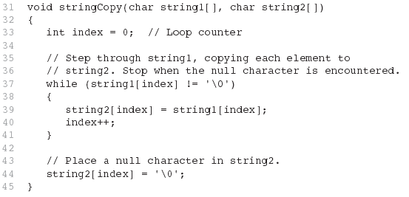
From Program 10-9

Slide 93
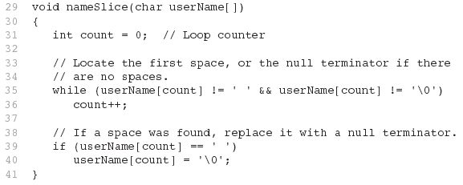
From Program 10-10

Slide 94
10.7
More About the C++ string Class

Slide 95
The C++ string Class
Special data type supports working with strings
#include <string>
Can define string variables in programs:
  string firstName, lastName;
Can receive values with assignment operator:
  firstName = "George";
  lastName = "Washington";
Can be displayed via cout
  cout << firstName << " " << lastName;

Slide 96
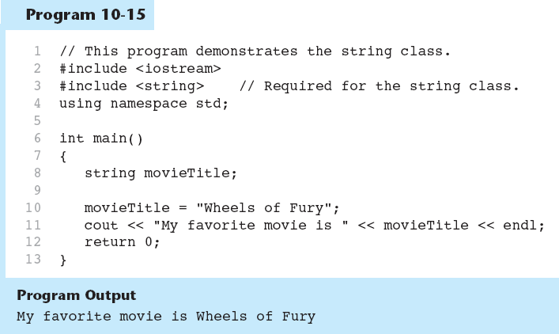

Slide 97
Input into a string Object
Use cin >> to read an item into a string:
  string firstName;
  cout << "Enter your first name: ";
  cin >> firstName;

Slide 98
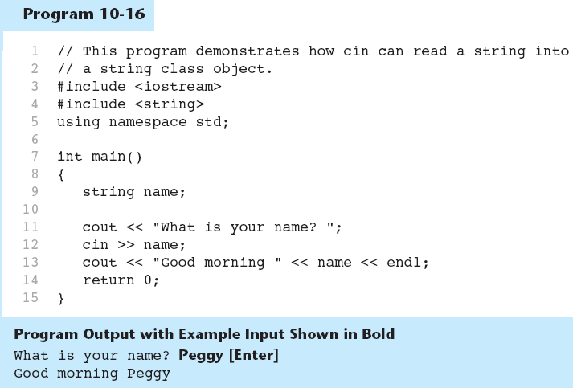

Slide 99
Input into a string Object
Use getline function to put a line of input, possibly including spaces, into a string:
  string address;
  cout << "Enter your address: ";
  getline(cin,address);

Slide 100
string Comparison
Can use relational operators directly to compare string objects:
  string str1 = "George",
  str2 = "Georgia";
  if (str1 < str2)
  cout << str1 << " is less than "
  << str2;
Comparison is performed similar to strcmp function. Result is true or false

Slide 101
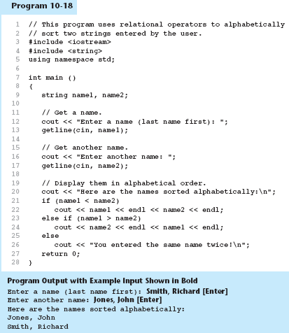

Slide 102
Other Definitions of C++ strings
Definition | Meaning
string name; | defines an empty string object
string myname("Chris"); | defines a string and initializes it
string yourname(myname); | defines a string and initializes it
string aname(myname, 3); | defines a string and initializes it with first 3 characters of myname
string verb(myname,3,2); | defines a string and initializes it with 2 characters from myname starting at position 3
string noname('A', 5); | defines string and initializes it to 5 'A's

Slide 103
string Operators
OPERATOR | MEANING
>> | extracts characters from stream up to whitespace, insert into string
<< | inserts string into stream
= | assigns string on right to string object on left
+= | appends string on right to end of contents on left
+ | concatenates two strings
[] | references character in string using array notation
>, >=, <, <=, ==, != | relational operators for string comparison. Return true or false

Slide 104
string Operators
string word1, phrase;
string word2 = " Dog";
cin >> word1; // user enters "Hot Tamale"
// word1 has "Hot"
phrase = word1 + word2; // phrase has
// "Hot Dog"
phrase += " on a bun";
for (int i = 0; i < 16; i++)
cout << phrase[i]; // displays
// "Hot Dog on a bun"

Slide 105
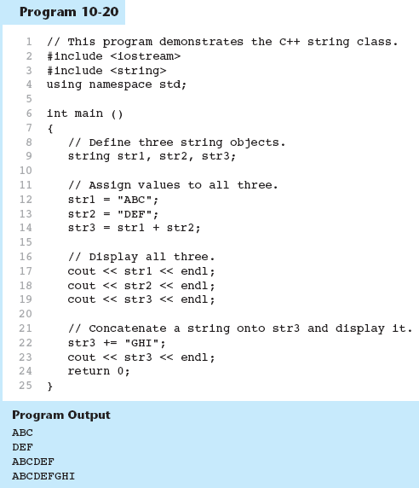

Slide 106
string Member Functions
Are behind many overloaded operators
Categories:
  assignment: assign, copy, data
  modification: append, clear, erase, insert, replace, swap
  space management: capacity, empty, length, resize, size
  substrings: find, substr
  comparison: compare
See Table 10-7 for a list of functions

Slide 107
string Member Functions
string word1, word2, phrase;
cin >> word1; // word1 is "Hot"
word2.assign(" Dog");
phrase.append(word1);
phrase.append(word2); // phrase has "Hot Dog"
phrase.append(" with mustard relish", 13);
// phrase has "Hot Dog with mustard"
phrase.insert(8, "on a bun ");
cout << phrase << endl; // displays
// "Hot Dog on a bun with mustard"

Slide 108
